Slide 1

TRAVELON
PRESENTATION

Slide 2
Content
Overview
Understanding the problems
Project objective
Target audience
Key Features
Project timeline

Slide 3
Overview
We have created an android social media application known as TravelOn.
We choose the Android platform because it is easy to access and available everywhere.

Slide 4
Understanding the problems
01
Due to Covid-19 pandemic Social distancing is followed throughout the world Human to Human interaction is limited.
02
Data security is been not given most priority by different Social Media companies.
03
Privacy of the user is neglected.
04
PM Modi’s call for self reliant India( Atm nirbhar Bharat).

Slide 5
Project objective
To solve this problem we have created an MADE IN INDIA social media application and we will call it TravelOn.

Slide 6



Target audience
All those individual how like interact with other people and like to live a socially active life.

Slide 7


Key Features
There are different features in TravelOn that make it an interesting social media application.
Some key features of this application are sign in ,log in , post , chat and many more.

Slide 8
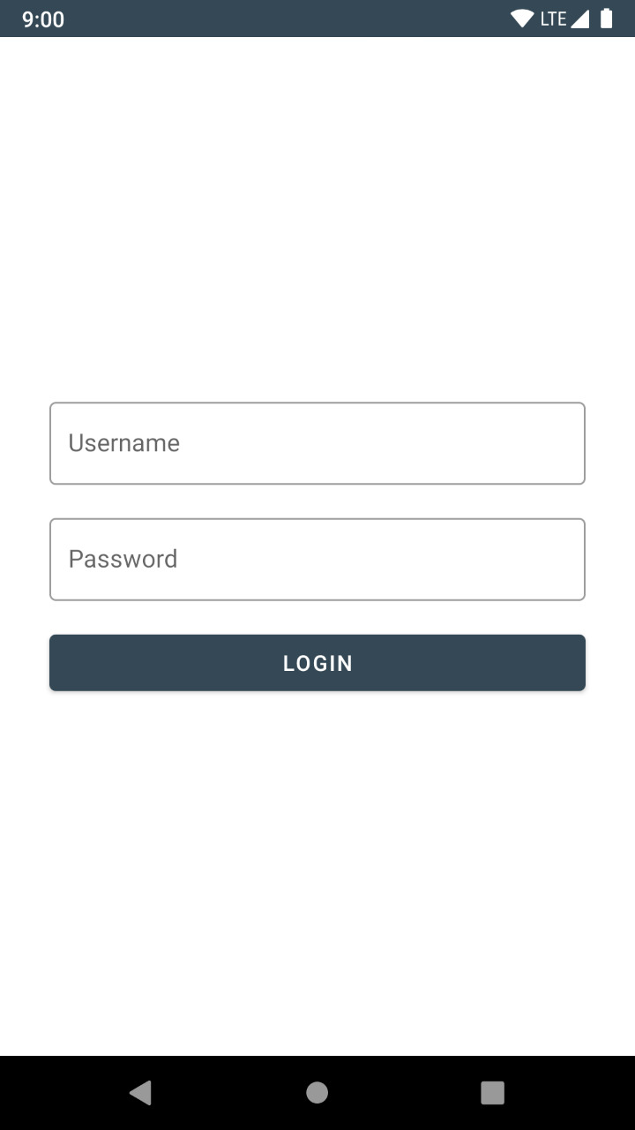
● Log In / Sign In –
This is our application Log in page. With this help, user can log in any time by entering the unique email address and its password

Slide 9
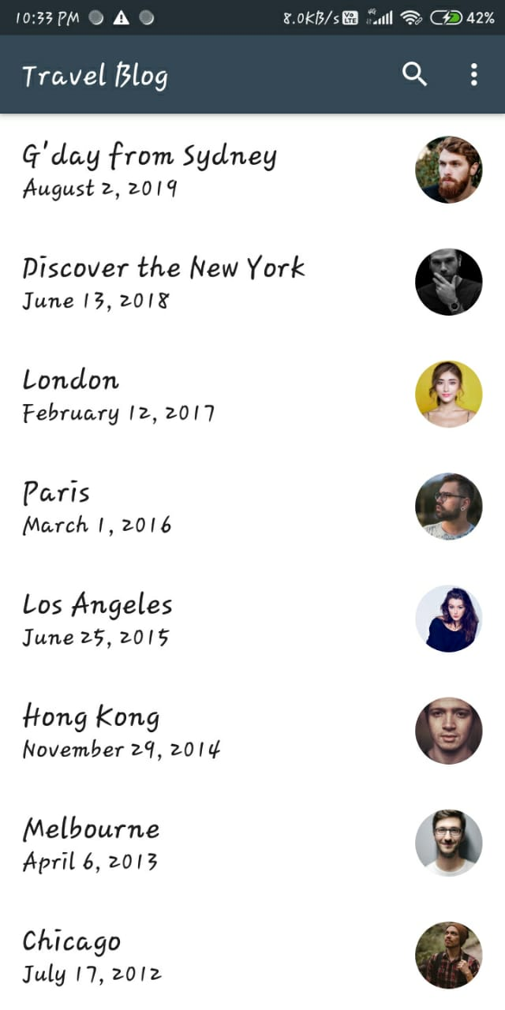
List Screen
After login the application, the user can see the list screen. For the list screen, we use .xml files; activity_main.xml and ite_main.xml.
In the first one we use Material type
toolbar , Recycler view and Swift refresh layout.

Slide 10
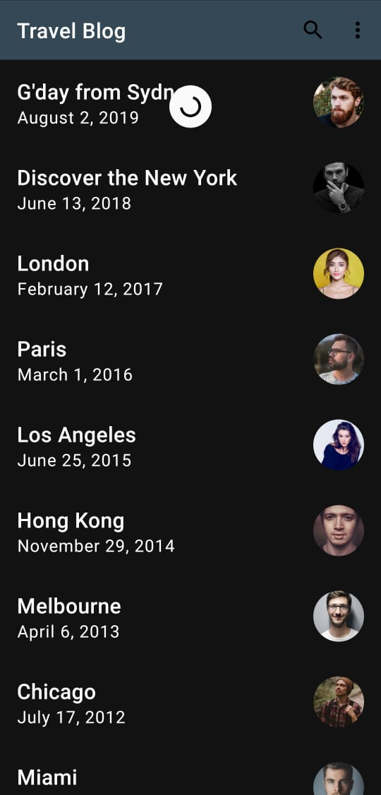
● Swift refresh
List screen also has the feature of swift refresh. Hence, by swiping from top to down, the user can refresh the list.

Slide 11
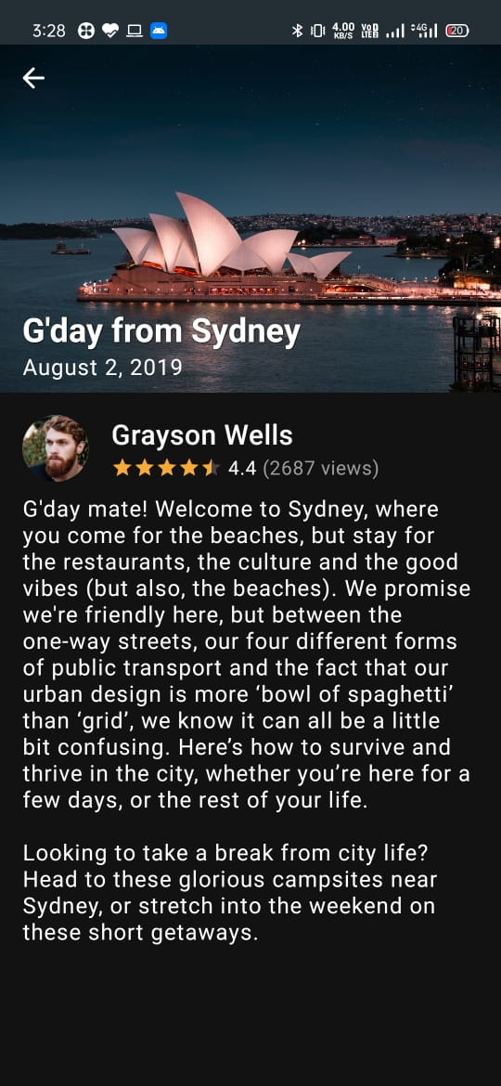
● Detail Screen:
Every blog in the list screen is followed by the detail screen. The blueprint of the detail screen is given below. In this detail screen, users will see the whole blog content.
With the content of three blogs, there will be an image of the user as well as
the rating of the blog with the stars for rating. It will also show the number of people
who have given their rating.

Slide 12
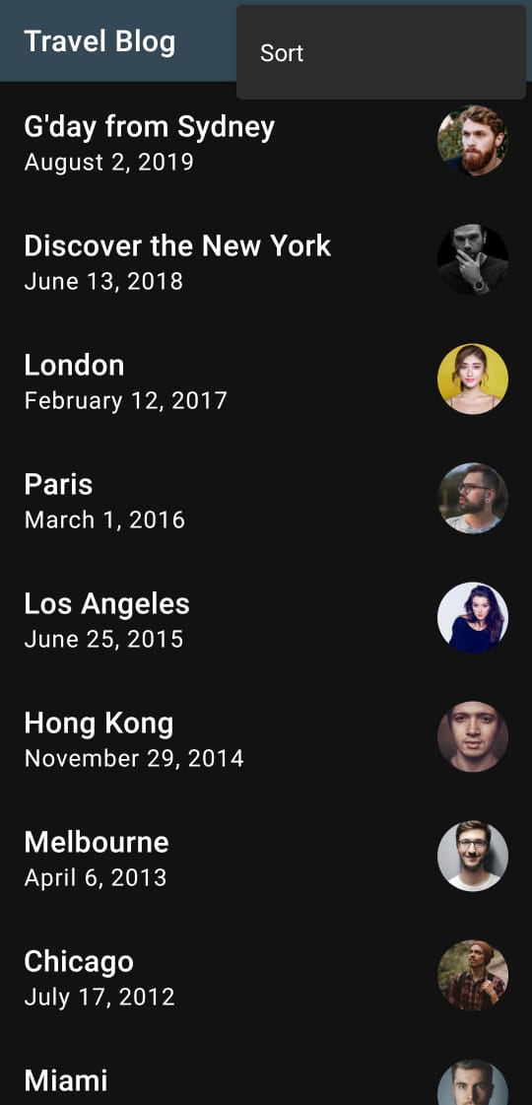
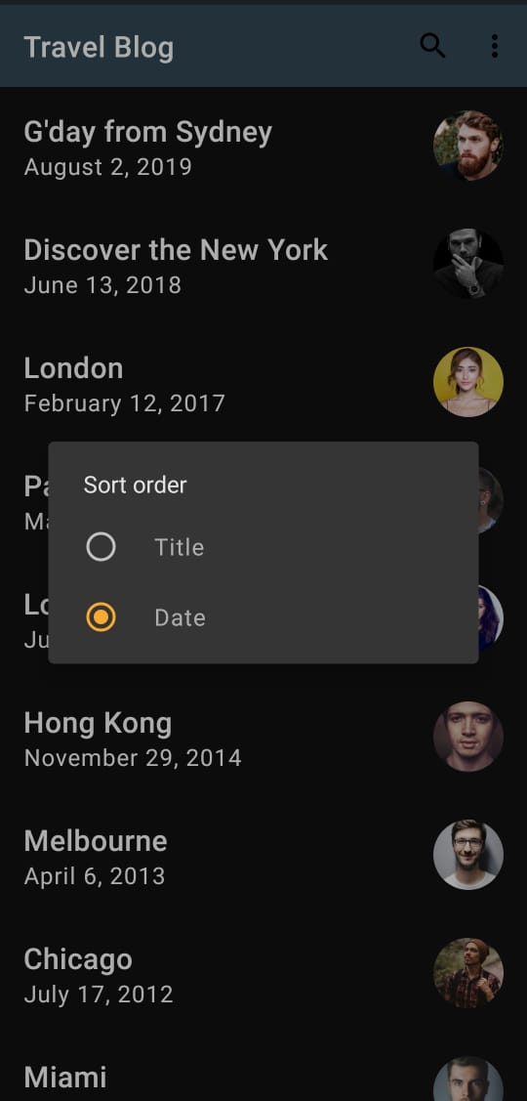
● Sort the blogs:
In the list screen there is a feature of sorting for user convenience. Users can sort the list according to the date of the blog release or by the title of the blogs. This will help the user to find the blog easily.

Slide 13
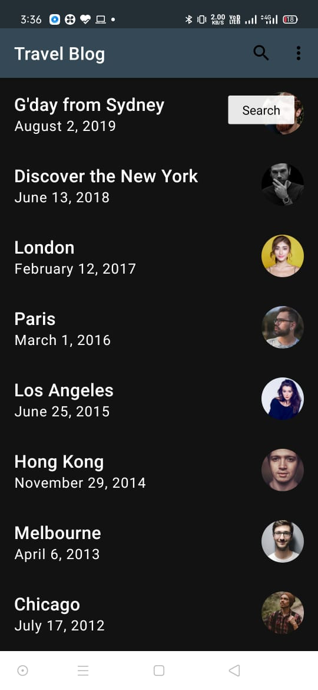
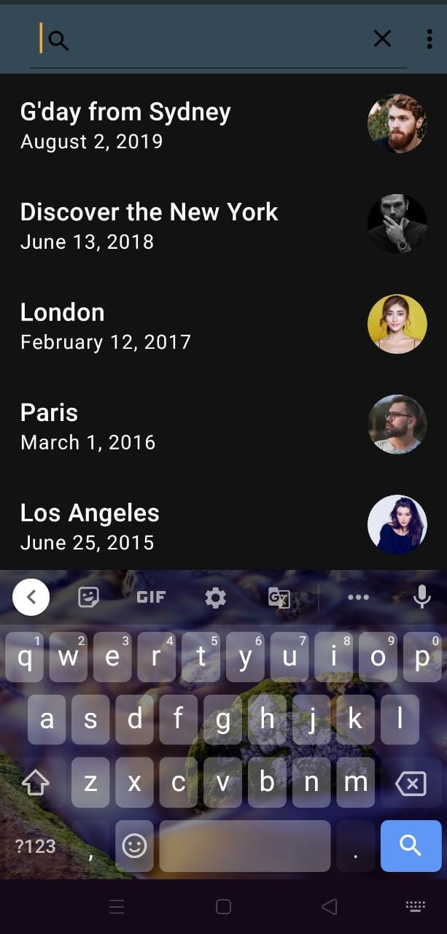
● Search the blog :
We add another convenient feature for the users i.e. searching by alphabets. In the list screen users will find a search symbol at the top right corner of the screen.
By tapping on the search symbol, an editable field will generate where the user can enter the title or the date.

Slide 14
Project timeline
JAN
FEB
MAR
APRIL
MAY
MAY
Project selected
Research
Learned Java
Development
Final Submit
Presentation
Selected a project
Gained knowledge about different technologies.
Gain knowledge about JAVA language
Start working on the project TalkOn (Coding)
Final submission
Final Presentation and VIVA

Slide 15
Thank you!

